Slide 1

Git

Slide 2
Version Control System
A version control system (VCS) allows us to track the history of a collection of files
Version Maintenance
Version Comparison
Preserves History of changes
Parallel Working
Easy Sharing
No Single Point of Failure - Central Storage

Slide 3
Vulnerability, Bug & Code Smell
What is
“Vulnerability”,
“Bug” and
“Code Smell” ?

Slide 4
Vulnerability
Vulnerability is a flaw in code or design that creates a potential point of security compromise. Few examples,
Credentials should never be hard-coded
Storing user’s passwords in clear-text in a database
"public static" fields should be constant
Class variable fields should not have public accessibility
Web applications should not have a "main" method

Slide 5
Bug
A software bug is an error, flaw, failure or fault in a computer program or system that causes it to produce an incorrect or unexpected result or to behave in unintended ways
The process of finding bugs is called debugging
Few Examples
"toString()" and "clone()" methods should not return null
Classes extending java.lang.Thread should override the "run" method
Loops with at most one iteration should be refactored
"StringBuilder" and "StringBuffer" should not be instantiated with a character
Methods should not be named "tostring", "hashcode" or "equals"

Slide 6
What is SonarLint?
SonarLint is an IDE extension that helps you detect and fix quality issues as you write code.
Its Like a spell checker & SonarLint squiggles flaws so that they can be fixed before committing code.
Features:-
1. Bug detection
2. Instant feedback
3. Know what to do
4. Learn from your mistakes
5. Easy to Use

Slide 7
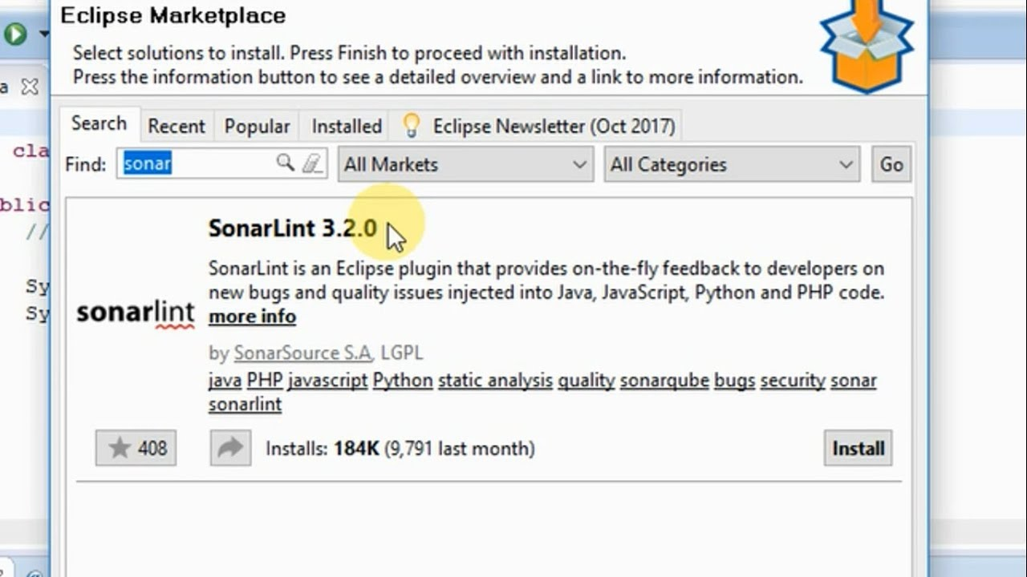
SonarLint in Eclipse
https://www.sonarlint.org/eclipse/

Slide 8
Code Smell
Code smells are not usually a bug in the sense that code doesn’t work, but rather, a case where the code could (and probably should) be better. The code can be awkward to use, possibly hard to read or understand, maybe unnecessarily complicated or convoluted.
For example:-
Lengthy Methods
Unused Variables
Duplicating same literal for multiple times
Duplicated Methods in the Same or Different Class
Leaving commented code

Slide 9
Git & GitHub
Source Code Repositories
- What
- Why
- Examples
Why Git & How it works
GitHub vs BitBucket vs GitLab
Git Terminology (Check-in, Check-out vs Push, Pull)

Slide 10
Why Git ?
Git
Git utilizes multiple repositories: a central repository and a series of local repositories. Local repositories are exact copies of the central repository complete with the entire history of changes. In Git, work is comprised of three parts: 1. Master 2. Branches 3. Tags Advantages:- 1. It’s faster to commit. In Git, we will work mostly on our local repository and only committing to the central repository when work done 2. No more single point of failure. With Git, each developer has the own repository, so it doesn’t matter if the central repository is broken. Developers can continue to commit code locally until the central repository has been fixed, and then they can push their changes. 3. It’s available offline. Git can work offline, allowing team to continue working without losing features even if they lose connection. 4. It’s Efficient. Git is open source and cross-platform, so support is available for all platforms, multiple sets of technologies, languages, and frameworks and it’s supported by virtually all operating systems. Disadvantages: the ever-growing complexing of history logs.

Slide 11
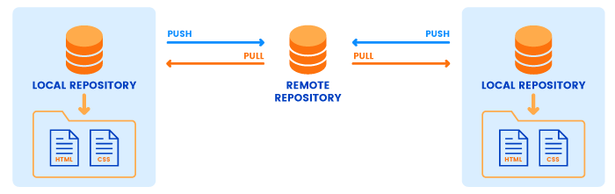
How Git Works

Slide 12
Important Git Commands
Command | Description
git clone ssh://git@github.com/[username]/[repository-name].git | Create a local copy of a remote repository
git add [file-name.txt] | Add a file to the staging area
git commit -m "[commit message]" | Commit changes to Local repository
git stash | Stash changes in a dirty working directory
git push | Push changes to remote repository
git pull | Update local repository to the newest commit
git diff [source branch] [target branch] | Preview changes before merging

Slide 13
GitHub Repository Name
ELF-06June19-<CompanyShortName>-<FirstNameLastName>
Ex:-
ELF-06June19-Covalense-PraveenD
ELF-06June19-TechChefs-PraveenD
ELF-06June19-TestYantra-PraveenD

